Slide 1


Deepening AI Foundations
Strategic and basic technical knowledge for advanced AI use.

Slide 2
Agenda
Why Foundations Matter for Advanced Users
The AI Landscape
Understanding AI Capabilities vs. Limitations
The Technical Stack:
  Machine Learning
  Deep Learning & Neural Networks
  Large Language Models
  How Generative AI Models are Created
Quality Assessment Framework
Integration Thinking - AI in Business Workflows
How These Foundations Connects to the Course Sections ?
Notes:
אנחנו הולכים להבין מה זה בינה מלאכותית, להכיר את הסוגים השונים של הבינה המלאכותית שקיימים ולהבין איפה הבינה הגנרטיבית ממוקמת ביניהם, אנחנו הולכים להכיר את הטכנולוגיות שעומדות בבסיס הבינה המלאכותית ולהכיר את ההתפתחות שלהן על גבי ציר הזמן.
לבסוף, אנחנו הולכים להבין בקווים כלליים איך יוצרים מודל חדש של בינה מלאכותית.
בסוף ההרצאה הזו אתם אמורים לצאת עם ידע טכני מספק, שיאפשר לכם להבין למה הטכנולוגיה הזו שאתם משתמשים בה היא לא קסם, להבין למה ואיך כל הזמן יוצאים עוד ועוד מודלים ואפליקציות שמבוססות על המודלים האלו, ולהתחיל לפתח את החוש הביקורתי כלפי מה הטכנולוגיה הזו יכולה ולא יכולה לעשות, מתוך היכרות מעמיקה יותר עם איך היא בנויה.

Slide 3

Why Foundations Matter for Advanced Users?
You're Not Just Using AI Anymore - You're Building With It!
Strategic Foundation = Better Decisions Understanding AI's capabilities and limitations is crucial for choosing the right tool, avoiding costly mistakes, and building solutions that actually work.

Slide 4
The AI Landscape
Predictive AI
Classification AI
Forecasting sales, identifying risks, predicting customer behavior.
Sorting emails, categorizing support tickets, content moderation.
Use for: Data analysis projects, business intelligence dashboards.
Use for: Automated workflows, content organization.
Generative AI
Augmented AI
Creating content, answering questions, code generation.
Enhancing human decision-making, providing intelligent suggestions.
Use for: Custom GPTs, content creation, no-code app development.
Use for: Business analytics, enhanced productivity tools.
Notes:
יצירת חוזי עתידי - קלסיפיקציה, יצירה, קבלת החלטות מושכלת

Slide 5
AI Capabilities vs. Limitations
This knowledge helps you set realistic expectations, design appropriate workflows, and create necessary safeguards in your applications.
What AI Excels At
What AI Struggles With
Pattern recognition from large datasets
Real-time information beyond training data
Generating content based on learned patterns
True reasoning vs. pattern matching
Processing structured and unstructured data quickly
Context that requires human experience
Automating repetitive cognitive tasks
Handling edge cases and exceptions
Notes:
בסופו של דבר מודל AI מוגבל למידע שהוא אומן עליו, ולתבניות שחזרו פעמים רבות בנתונים, ולכן הוא עשוי להיות חלש יותר בסיטואציות חדשות שלא תועדו בעבר או שלא נעשה מאמץ לבנות מהן משהו שאפשר לאמן איתו מודל (ואפשר להגדיר אותן כניסיון חיים של בן אדם למשל).

Slide 6
The Technical Stack

Slide 7





The Technical Stack
Strategic Insight: Higher levels are easier to use but less customizable. Lower levels offer more control but require more technical knowledge. Choose based on your specific needs and technical capacity.
Business Application Layer
Custom solutions for specific needs
AI Agents
ChatGPT, Claude, Custom GPTs
Large Language Models
GPT, Claude, Gemini
Deep Learning
Neural Networks, Transformers
Machine Learning & Infrastructure
Algorithms, Training Data, Cloud, APIs
Notes:
הפירמידה - למעלה - הכלים שכבר בשימוש - למטה יותר - הכלים שבעזרתם זה נבנה

Slide 8



Machine Learning Foundations
Why This Matters for Your Applications?
Machine Learning Core Principle: Systems learn patterns from data to make predictions or decisions
Data Quality = Output Quality
Your AI tools will only be as good as the data you feed them.
Training Limitations
AI models reflect their training data's biases and knowledge cutoffs.
Pattern Dependency
AI works best with clear, consistent patterns in data.
Practical Application: When building custom GPTs, provide high-quality, representative examples. When using AI for data analysis, ensure your data is clean and relevant.

Slide 9

Deep Learning and Neural Networks
The Engine Behind Modern AI Tools
Deep Learning = Complex Pattern Recognition
Complex Pattern Recognition
Multiple layers process information hierarchically, enabling understanding of context and relationships.
Computational Requirements
More sophisticated AI requires more resources, affecting speed and cost of implementation.
Customization Potential
The more layers, the more you can fine-tune for specific business use cases.

Slide 10








Large Language Models
The Foundation of Your Custom AI Solutions
What Makes LLMs Powerful:
Massive Training Data
Context Understanding
Trained on diverse text datasets across multiple languages and formats
Comprehends meaning across long conversations
Strategic Limitations
Human-like Responses
Token limits, knowledge cutoffs, hallucination risks
Generates natural language content

Slide 11
How Generative AI Models are Created
Enhancing Performance
Reinforcement Learning from Human Feedback (RLHF)
Deployment
Collecting and Preparing Data
Making the AI Available to Users
Pre-Training
1
2
3
4
5
6
7
8
Building the Computational Model
Fine-Tuning
Testing and Evaluating
Continuous Improvement
Making the Model More Useful for Specific Tasks
Transformers
Setting Parameters

Slide 12
How Generative AI Models are Created
1
Collecting and Preparing Data
Massive amounts of text (books, articles, websites) are collected to train the AI.
Key Insight: The model does not have updated knowledge after its last training date.
2
Building the Computational Model (Transformers, Setting Up Parameters)
AI researchers design a Transformer model, a deep learning architecture that understands text by analyzing relationships between words. In this model, they set up the parameters, which control how the AI processes information. The final parameters reflect the model's learning.
Models like GPT-4 have hundreds of billions of parameters.
Key Insight: The AI does not "think" like a human—it's a computational model!

Slide 13
How Generative AI Models are Created
3
Pre-Training: Where AI Learns
The model is trained to predict the next word in a sentence using a method called self-supervised learning. Example: Given the sentence "The sun rises in the ___.", the AI learns that "east" is a likely word. The parameters are adjusted based of the learning of the model.
Key Insight: The AI does not "know" - it only predicts what words are statistically likely to come next. This can lead to hallucinations (confidently generation of wrong answers that sound believable).
4
Fine-Tuning: Making the Model More Useful for Specific Tasks
The AI is fine-tuned on specific examples, such as polite conversation, technical support, or customer service.
Key Insight: Different AI models are fine-tuned for different purposes. A chatbot might be tuned for friendliness, while a legal AI might be tuned for professionalism.

Slide 14
How Generative AI Models are Created
5
Enhancing Performance: Reinforcement Learning from Human Feedback (RLHF)
Humans rate the AI’s responses, ranking which ones are most helpful, safe, and accurate. The AI is then adjusted based on this feedback.
Key Insight: This makes AI responses more aligned with human values, but it can also introduce bias depending on the perspectives of the reviewers.
6
Testing and Evaluating
AI developers test the model by giving it thousands of questions and evaluating its accuracy, fairness, and safety. If issues are found, further fine-tuning is done.
Key Insight: Even with testing, AI can still make mistakes or biased assumptions, so users should critically evaluate responses instead of assuming everything is 100% accurate.

Slide 15
How Generative AI Models are Created
7
Deployment: Making the AI Available to Users
The model is made available to users in applications like ChatGPT, Google Gemini, or Claude.
Key Insight: The quality of the AI’s responses depends on how users interact with it.
Clear, specific prompts lead to better answers. Vague or misleading prompts can cause inaccurate or irrelevant responses.
AI doesn’t "think" like a human - it generates text based on patterns, so guiding it properly improves its usefulness.
8
Continuous Improvement
AI companies update models based on retraining with new data and improve capabilities.
Key Insight: Its performance and abilities are changing rapidly, with each company want to be the first and the best

Slide 16
Quality Assessment Framework
Understanding training processes (pre-training, fine-tuning, RLHF) is crucial for critical evaluation of AI outputs.
The "Trust but Verify" Approach:
Red Flags to Watch For:
Validation Strategies:
Overconfident responses about recent events
Cross-check factual claims with reliable sources
Specific facts without sources
Test AI responses with known correct examples
Complex calculations without showing work
Look for consistency across multiple queries
Responses that seem "too perfect"
Understand the AI's training limitations
For Your Applications: Build verification steps into workflows. Educate end-users about AI limitations. Design interfaces that encourage critical thinking.

Slide 17




Integration Thinking - AI in Business Workflows
How AI Fits into Larger Systems?
AI as a Component, Not a Solution:
AI enhances existing processes rather than replacing entire workflows
Most effective when combined with human oversight and other systems
Requires clear input/output specifications
Integration Considerations:
Data Flow
Human-in-the-Loop
How information moves between AI and other systems
Where human judgment is essential
Error Handling
Scalability
What happens when AI fails or produces poor output
How the solution grows with increased usage
Context for Your Learning: Understanding integration helps you design better custom GPTs and no-code applications that work well in real business environments.

Slide 18
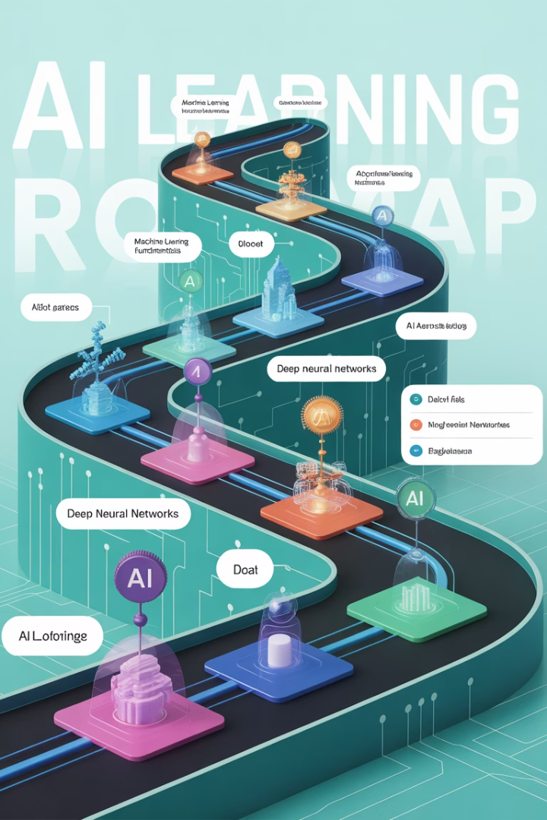
How These Foundations Connects to the Course Sections ?
Course Section
How Foundations Apply
Custom GPTs
Understanding LLM capabilities helps you write better instructions. Knowledge of limitations guides your knowledge base design.
No-Code Development
AI type knowledge helps you choose the right platform. Integration thinking guides your app architecture decisions.
Data Analysis and Decision Making
ML understanding helps you interpret AI-generated insights critically. Quality assessment skills prevent incorrect business decisions.

Slide 19





Key Takeaways for Advanced Users
AI is a Strategic Tool, Not Magic
Success depends on matching AI capabilities to specific business problems.
Think Like a Solution Architect
Consider the entire workflow, not just the AI component.
Build Responsibly
Understand and communicate AI limitations to users.
Prepare for Continuous Learning
AI capabilities evolve rapidly - stay informed about new developments.

Slide 20
Sources of Information
https://www.youtube.com/watch?v=LPZh9BOjkQs
https://www.youtube.com/watch?v=wjZofJX0v4M
Notes:
מי שרוצה עוד העמקה - יש פה שני סרטונים מעולים שמסבירים על הטכנולוגיה שעומדת מאחורי ה-AI הגנרטיבי.
הם כן די כבדים ומצריכים עוד ידע, אבל בתוך הסרטון הוא מקשר לסרטונים נוספים מהם אפשר לרכוש את הידע החסר.

Slide 21
Questions?

